Slide 1

Profıtable ıtalıan restaurant ın new york
Sarp Özekmekçi

Slide 2
INTRODUCTION
Revenue of a restaurant is directly based on its sales which can be assumed to be depending on two main areas.
First one is the quality and cost of the product. Food that are not delicious will not sell much and for an expensive food to be profitable it has to bring something unique to the table. Important point with this area is that these are mainly not dependent on the outside factors and can be improved after the restaurant is opened.
Second one is the location, more explicitly, competition around the restaurant and its compliance with the customer portfolio at that neighbourhood. These cannot be changed after its done or amends would be expensive.
For above reasons, location of a newly established restaurant is very important and needs to be carefully evaluated. On this Project, optimum location for an Italian restaurant will be selected.

Slide 3

DATA and METHODOLOGY
Main focus will be the intensity of Italian restaurants at a certain neighbourhood.
At a location with high density of Italian restaurants, competetion will be more fierce resulting in potential lower revenues.
However there are two cases, if the density is high but the ratings are low then it could be considered as an opportunity. Assumption here is that there is demand for it with no satisfaction.
If the density is high with some highly rated Italian Restaurants, that location would not be ideal.
At a location with lower density of Italian restaurants, competetion will be less resulting in potential high revenues.
However again there are two cases, if the density is low both for Italian restaurants and for restaurants in general it can be assumed that there is not demend for a restaurant at the location. In this case, that location would not be recommended.
If the density of Italian restaurants is low but in terms of restaurants in general the density is above a certain level, it can be assumed as potentially profitable location. Assumption here is that if there are restaurants, there is a demand for them despite the lack of Italian ones.

Slide 4

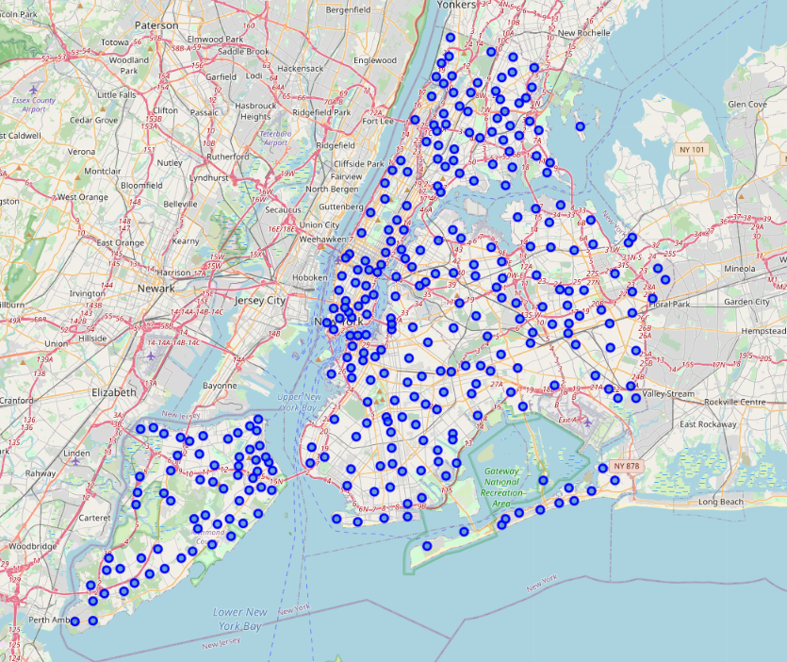
RESULTS
Visual depiction of the neighbourhoods of New York is created as can be seen on the right.
There are 5 boroughs and 306 neighbourhoods.

Slide 5
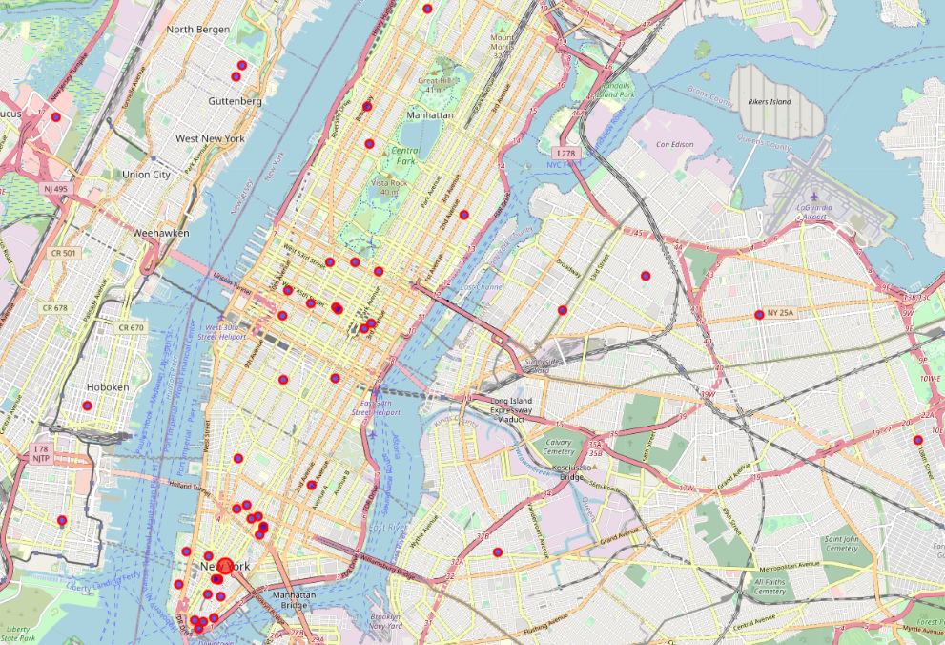
RESULTS
Visual depiction of the Italian restaurants of New York is created as can be seen on the right.
There are 50 of them that can be shown with the request because of the limitations of the Foursquare API subscription.

Slide 6
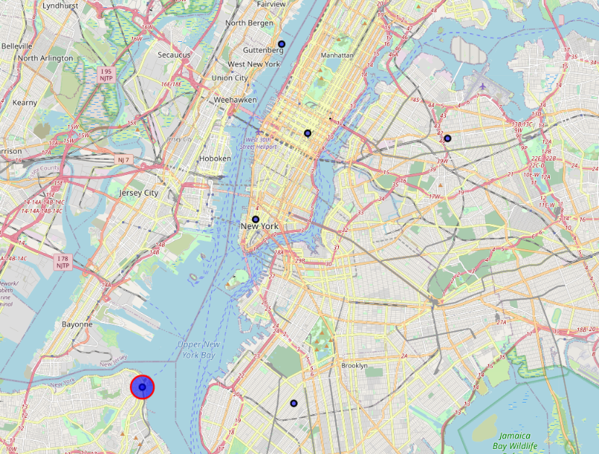
RESULTS
Results of the clustering with K-Means method for 6 clusters is visualised on the map. 6 black markers are the centroids for the clusters.
According to this map, optimum location will be Area 6, bottom left of the map which is Thompkinsville.
 | Area 1 | Area 2 | Area 3 | Area 4 | Area 5 | Area 6
Number of restaurants | 6 | 23 | 14 | 4 | 2 | 1

Slide 7
DISCUSSION
Because of the low sample size, results are not very satisfying. 50 restaurants in such a big area yielded no clusters with the DBScan methodology.
With this low sample size, K-Means yielded better results. With 6 predefined clusters, data is analysed and optimum location is provided.

Slide 8
CONCLUSION
According to this map, optimum location will be Area 6, bottom left of the map which is Thompkinsville.

